Slide 1

Database Management system
Lecture 11
Distributed Database
Architectures
Dr. Rihab Mohamed Naceur ABDELKRIM
E-mail: rihab@su.edu.sa
2017 - 2018

Slide 2
Distributed Databases
A distributed database is a collection of multiple interconnected databases, which are spread physically across various locations that communicate via a computer network.

Slide 3
Features
Databases in the collection are logically interrelated with each other.
Data is physically stored across multiple sites.
The processors in the sites are connected via a network.
A distributed database incorporates transaction processing.

Slide 4
Distributed Database Management System
A distributed database management system (DDBMS) is a centralized software system that manages a distributed database in a manner as if it were all stored in a single location.

Slide 5
Advantages of Distributed Databases
Modular Development.
More Reliable.
Better Response.
Lower Communication Cost .

Slide 6
Adversities of Distributed Databases
Need for complex and expensive software: to provide data transparency and co-ordination across the several sites.
Processing overhead: Even simple operations may require a large number of communications and additional calculations to provide uniformity in data across the sites.
Data integrity: The need for updating data in multiple sites pose problems of data integrity.

Slide 7
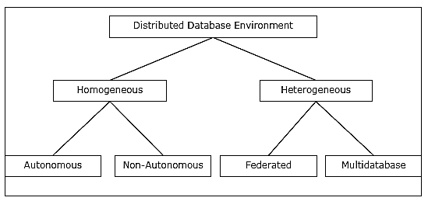
Types of Distributed Databases

Slide 8
Homogeneous Distributed Databases
In a homogeneous distributed database, all the sites use identical DBMS and operating systems. Its properties are:
The sites use very similar software.
The sites use identical DBMS or DBMS from the same vendor.
Each site is aware of all other sites and cooperates with other sites to process user requests.
The database is accessed through a single interface as if it is a single database.

Slide 9
Types of Homogeneous Distributed Database
Autonomous: Each database is independent that functions on its own.
Non-autonomous: Data is distributed across the homogeneous nodes and a central or master DBMS co-ordinates data updates across the sites.

Slide 10
Types of Heterogeneous Distributed Databases
Federated: The heterogeneous database systems are independent in nature and integrated together so that they function as a single database system.
Un-federated: The database systems employ a central coordinating module through which the databases are accessed.

Slide 11
Distributed DBMS Architectures
DDBMS architectures are generally developed depending on three parameters:
Distribution: It states the physical distribution of data across the different sites.
Autonomy: It indicates the distribution of control of the database system and the degree to which each constituent DBMS can operate independently.
Heterogeneity: It refers to the uniformity or dissimilarity of the data models, system components and databases.

Slide 12
Architectural Models
Some of the common architectural models are:
Client - Server Architecture for DDBMS
Peer - to - Peer Architecture for DDBMS
Multi - DBMS Architecture

Slide 13
Client - Server Architecture for DDBMS
This is a two-level architecture where the functionality is divided into servers and clients.
The server functions primarily encompass data management, query processing, optimization and transaction management.
Client functions include mainly user interface.
The two different client - server architecture are:
Single Server Multiple Client
Multiple Server Multiple Client (shown in the following diagram)

Slide 14
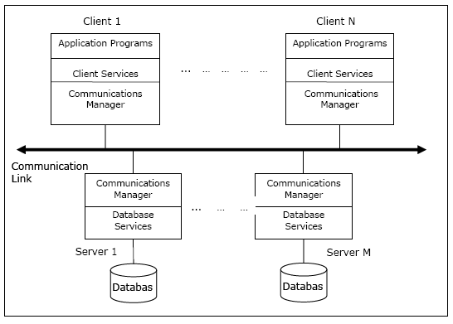

Slide 15
Peer- to-Peer Architecture for DDBMS
In these systems, each peer acts both as a client and a server for imparting database services.
The peers share their resource with other peers and co-ordinate their activities.
This architecture generally has four levels of schemas:
Global Conceptual Schema: the global logical view of data.
Local Conceptual Schema: logical data organization at each site.
Local Internal Schema: physical data organization at each site.
External Schema: user view of data.

Slide 16
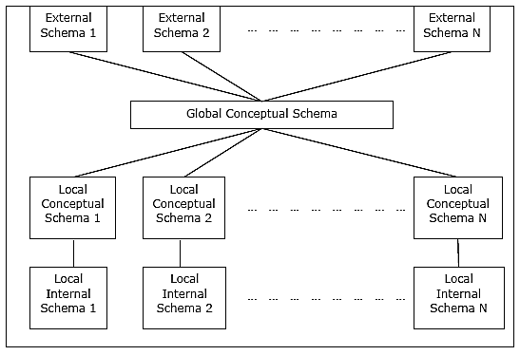

Slide 17
Multi - DBMS Architectures
This is an integrated database system formed by a collection of two or more autonomous database systems.
Multi-DBMS can be expressed through six levels of schemas:
1-Multi-database View Level.
2-Multi-database Conceptual Level.
3-Multi-database Internal Level.
4-Local database View Level.
5-Local database Conceptual Level.
6-Local database Internal Level.

Slide 18
Multi - DBMS Architectures
There are two design alternatives for multi-DBMS:
Model with multi-database conceptual level.
Model without multi-database conceptual level.

Slide 19
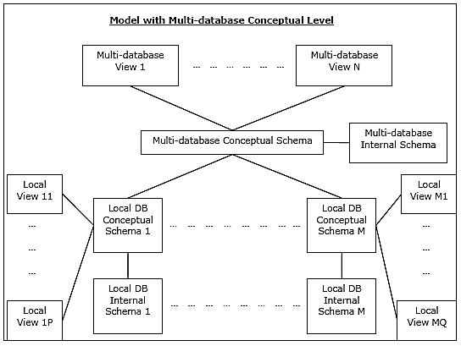

Slide 20
